Slide 1
Doing Data Science - Midterm Project
Michael (Branum) Stephan and Yang Zhang
For a link to the rmarkdown, see link

Slide 2
Findings
Some states have much more breweries than others, “CO” is the state with largest number of breweries.
IBU are missing in roughly half of the data collection. Because these are both critical measurements for beer classification, we provided both a traditional approach as well as a simplified approach to address missing values.
The scatterplot of ABV vs. IBU shows positive correlation. Additional evidence supports the claim that they can be used to differentiate IPA vs. non-IPA beers.
Using the ABV and IBU as parameters for KNN clustering, model accuracy reached upward of 85%. IPA’s proved to be higher in both ABV and IBU in most cases.
Utilizing the state population and number of different IPA beers brewed, we conducted a regional analysis to locate the best geographic region to perform product trials.

Slide 3
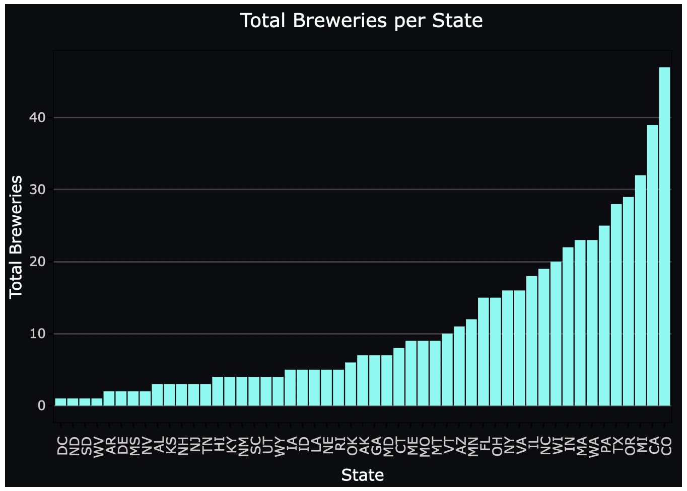
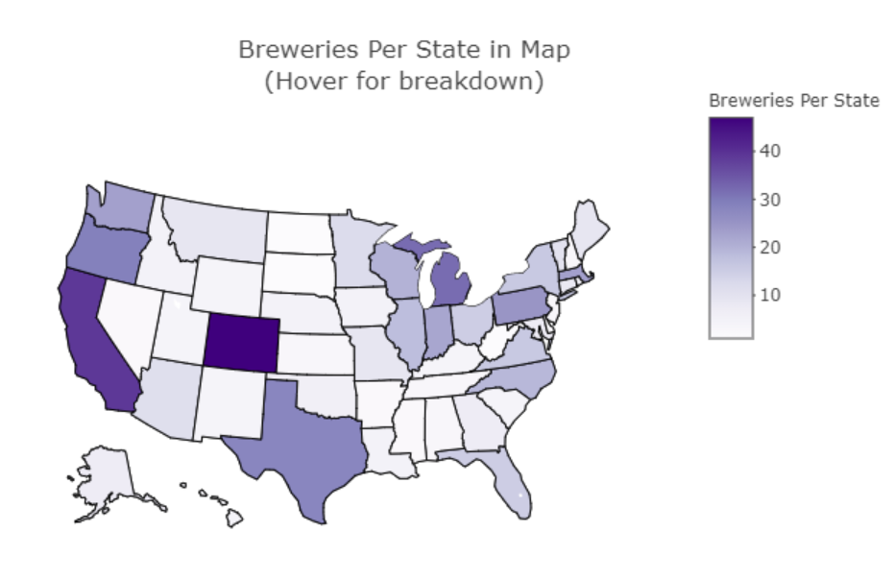
How many breweries exist per state?
Top 5 States
State | Number
CO | 47
CA | 39
MI | 32
OR | 29
TX | 28
Breweries per State by Map

Slide 4
Combining the breweries and beer data
By merging the two datasets together by their common key, “brewery_id”, we were able to leverage more information from the relationship between the datasets.
Merged output:
brewery_id
beer_name
beer_id
abv
Ibu
beer_style
serving_ounces
brewery_name
City
state

Slide 5
Statistics of ”NA” values within the Dataset
Column | NAs
brewery_id | 0
beer_name | 0
beer_id | 0
abv | 62/2410
ibu | 1005/2410
beer_style | 0
serving_ounces | 0
brewery_name | 0
city | 0
state | 0
*abv_corr | 0
*Ibu_corr | 52/2410
The dataset only has missing information in ABV and IBU values, but the missing values of IBU are present in almost half the dataset!
Because ABV and IBU are major features to be missing, we decided to proceed with two different approaches:
Remove all the items with NAs exist, items in total will be reduced to 1405
We think beer_style is the key variable—by each style beers are sharing common features. So we assign median value of each style to the ones with missing values in ABV and IBU. After the filling action, we have no NAs in ABU and just 52 (reduced 95%) NAs from previous dataset.

Slide 6
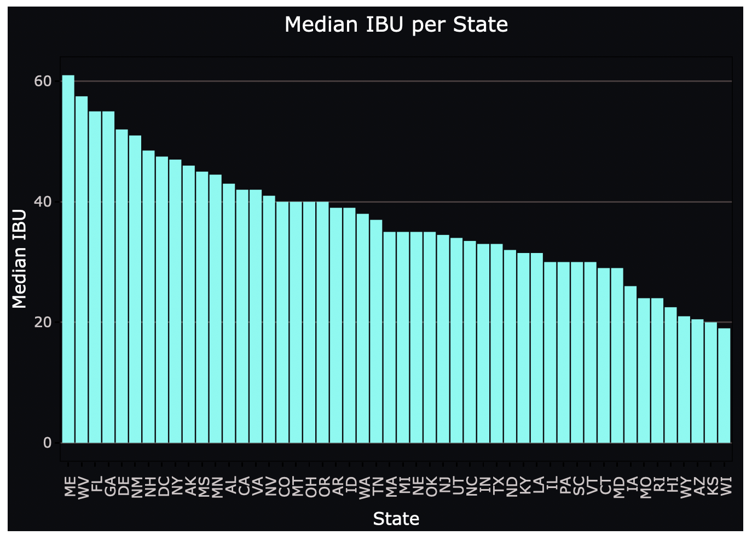
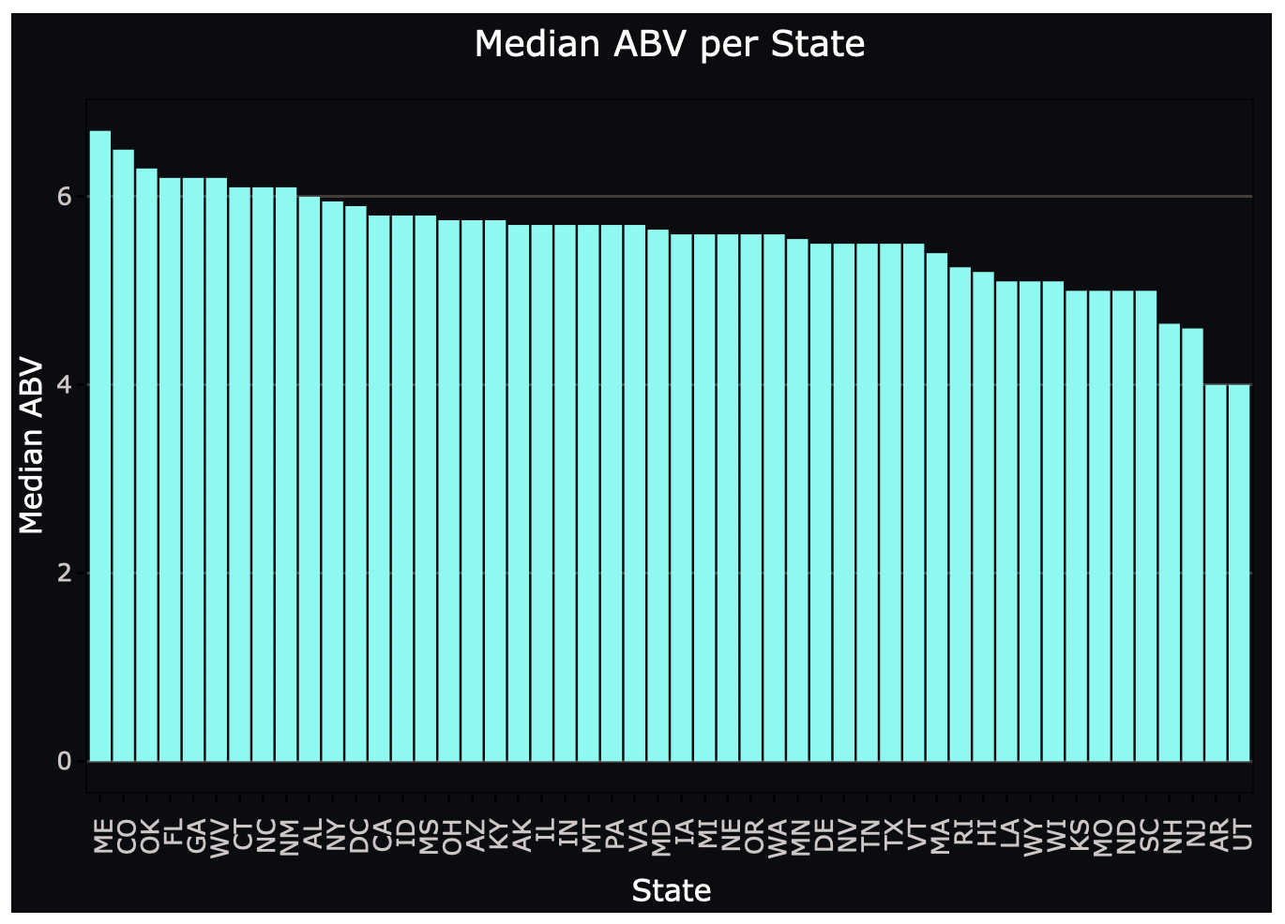
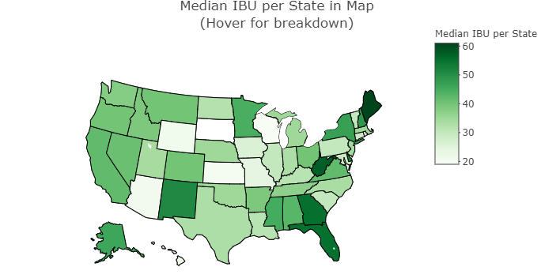
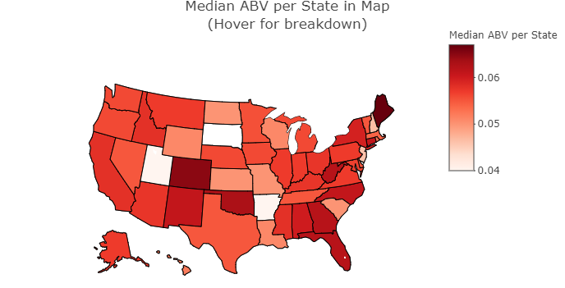
Median ABV and IBU per State
Median IBU per State by Map
Median ABV per State by Map

Slide 7
Maximum ABV and IBU per State
State | Beer Name | Max ABV
CO | Lee Hill Series Vol. 5 | 0.128
State | Beer Name | Max IBU
OR | Bitter B*tch | 138

Slide 8
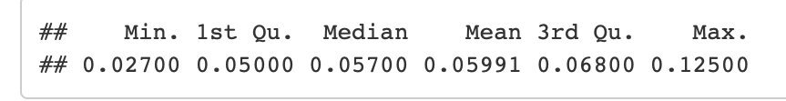
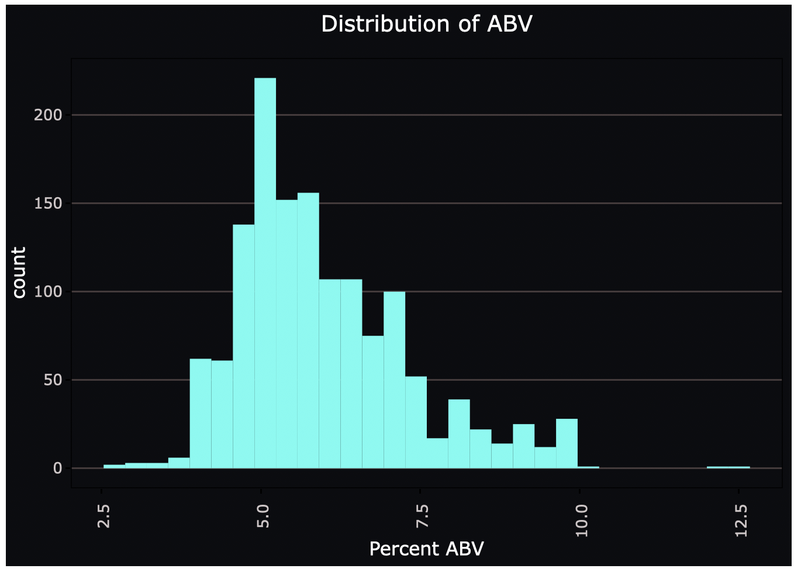
Distribution of ABV

Slide 9
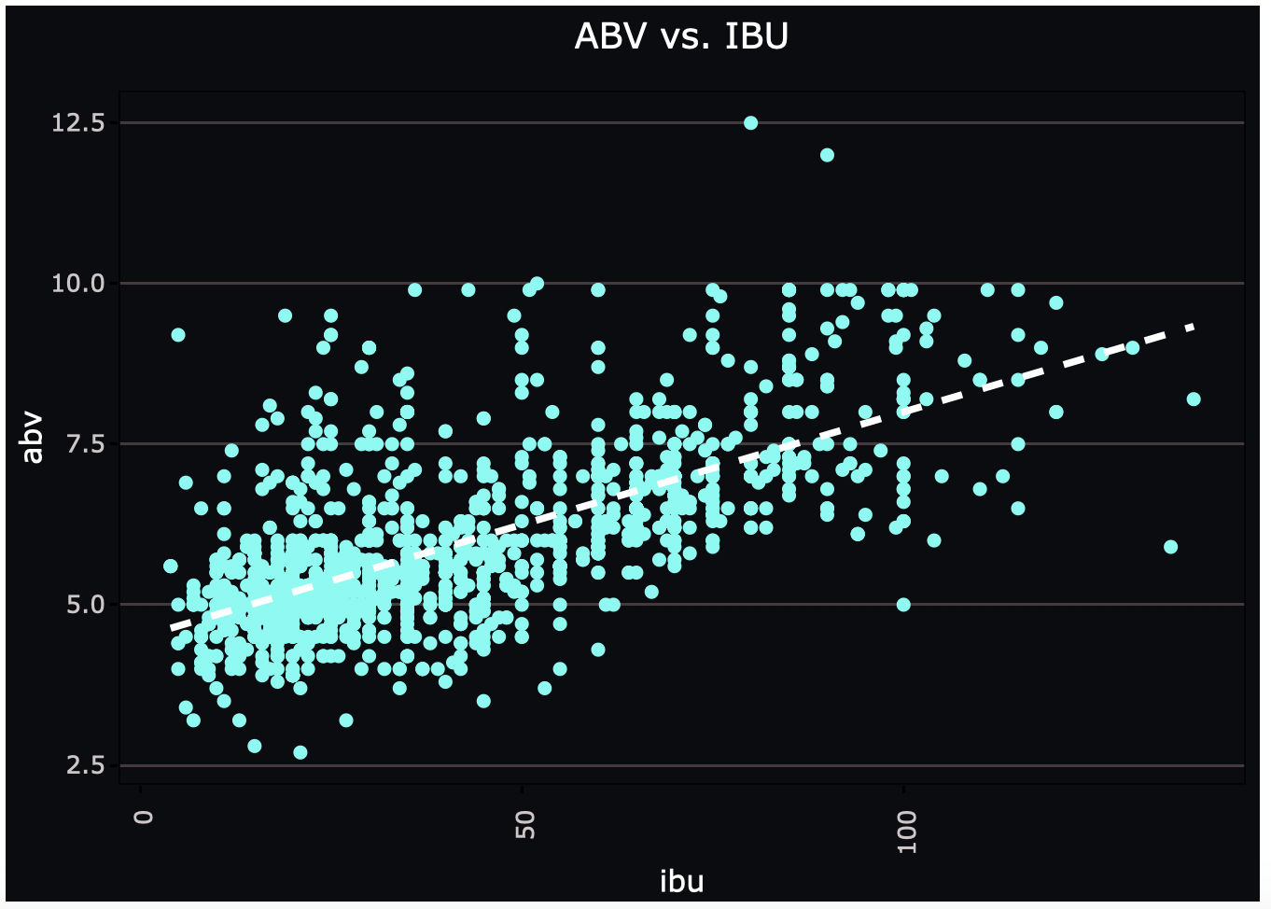
Correlation – ABV vs. IBU
It appears that there’s a linear relationship between IBU and ABV in this dataset.
Do buyers prefer more bitterness with stronger beers?

Slide 10
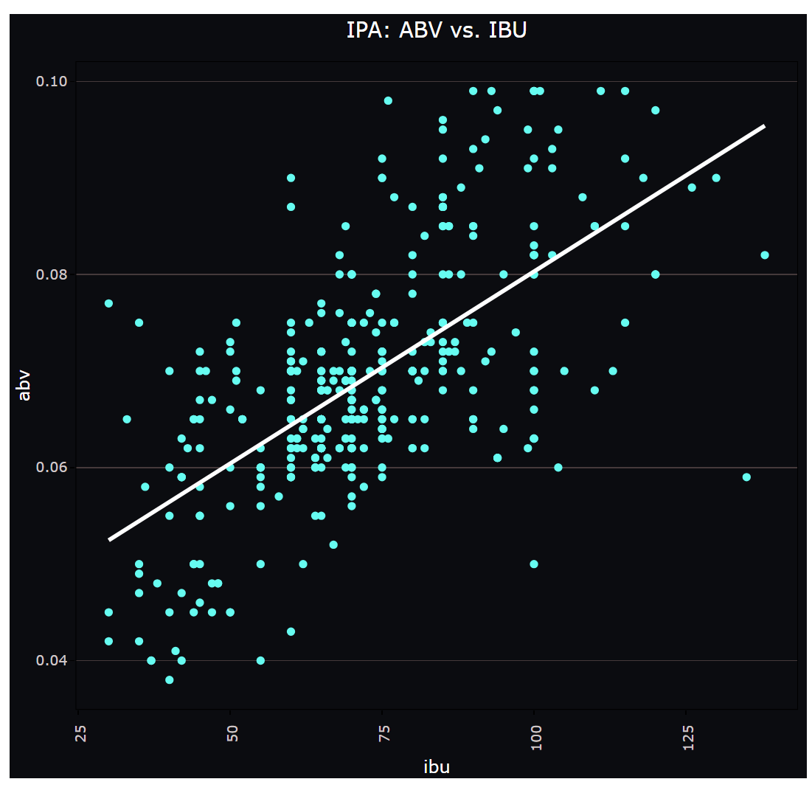
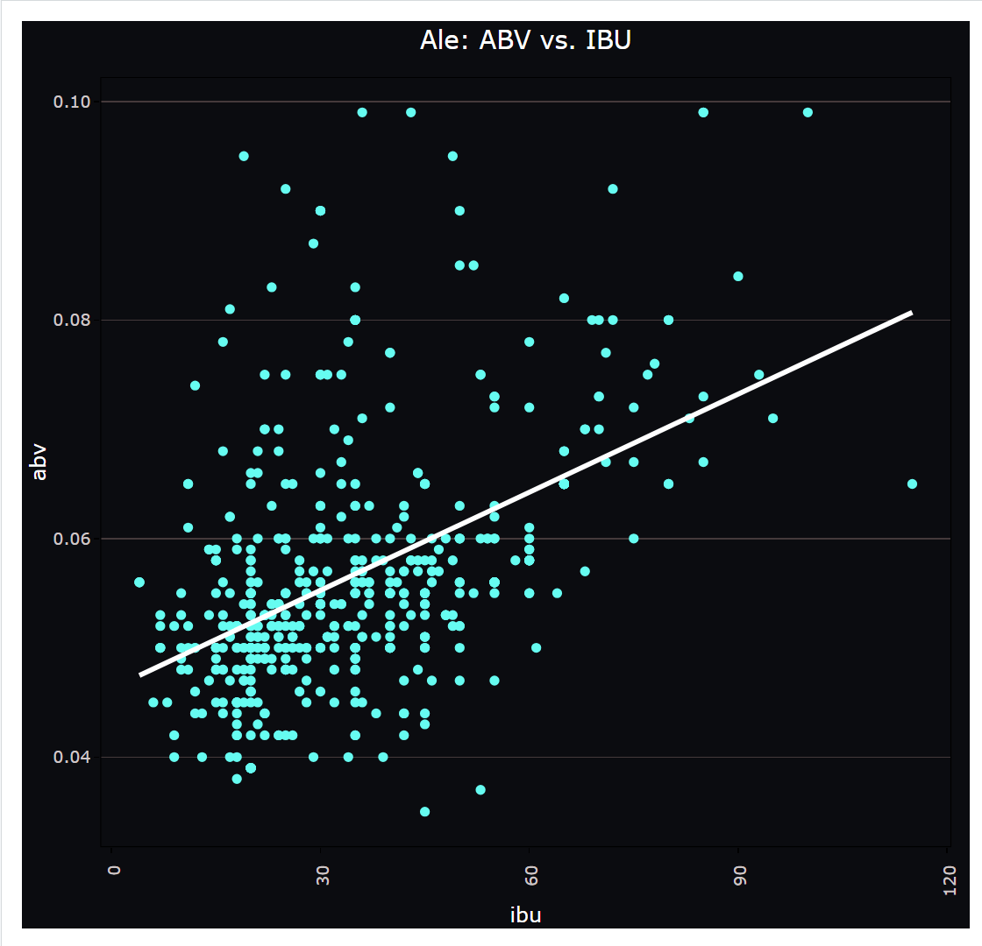
Correlation – ABV vs. IBU For Beer style：IPA and Ale
Beer style | Number
IPA | 385
Ale | 552
From visual IPA has higher ABV and IBU values and has better correlation.
The majority of non-IPA beers tend to have lower ABV and IBU values.

Slide 11
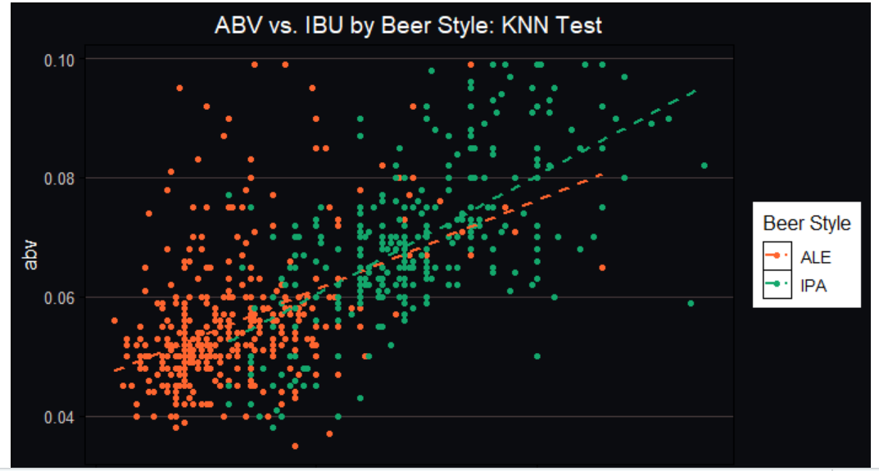
Correlation – ABV vs. IBU Plot Two Beer styles
Further visual evidences reflect that the correlation of ABV vs. IBU are different with Ale and IPA styles.
There is a visual boundary between styles at approximately 50 IBU.

Slide 12
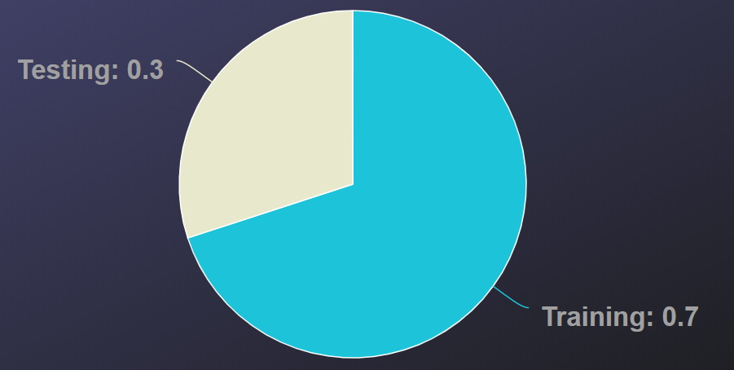
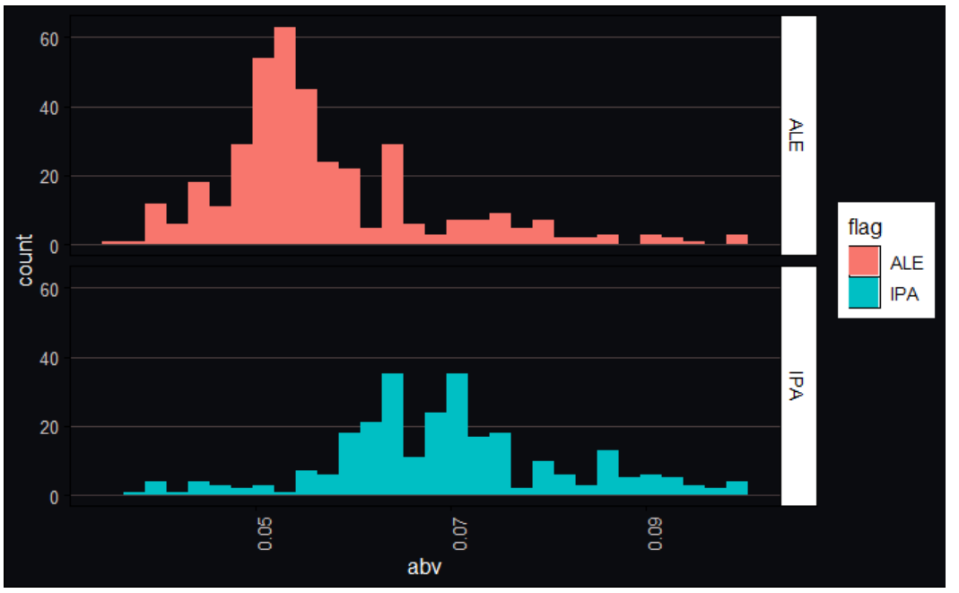
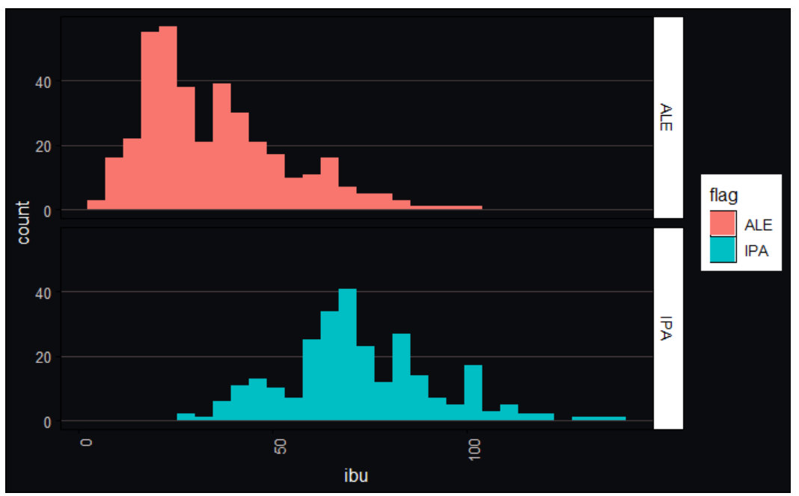
ABV vs. IBU relationship Investigation on Two Beer Styles Using KNN Clustering
Preparation for KNN clustering: Data Split into Training/Testing groups.
From the distributions, we can see notable differences between the two styles.
Training Data: ABV Distribution
Training Data: IBU Distribution

Slide 13
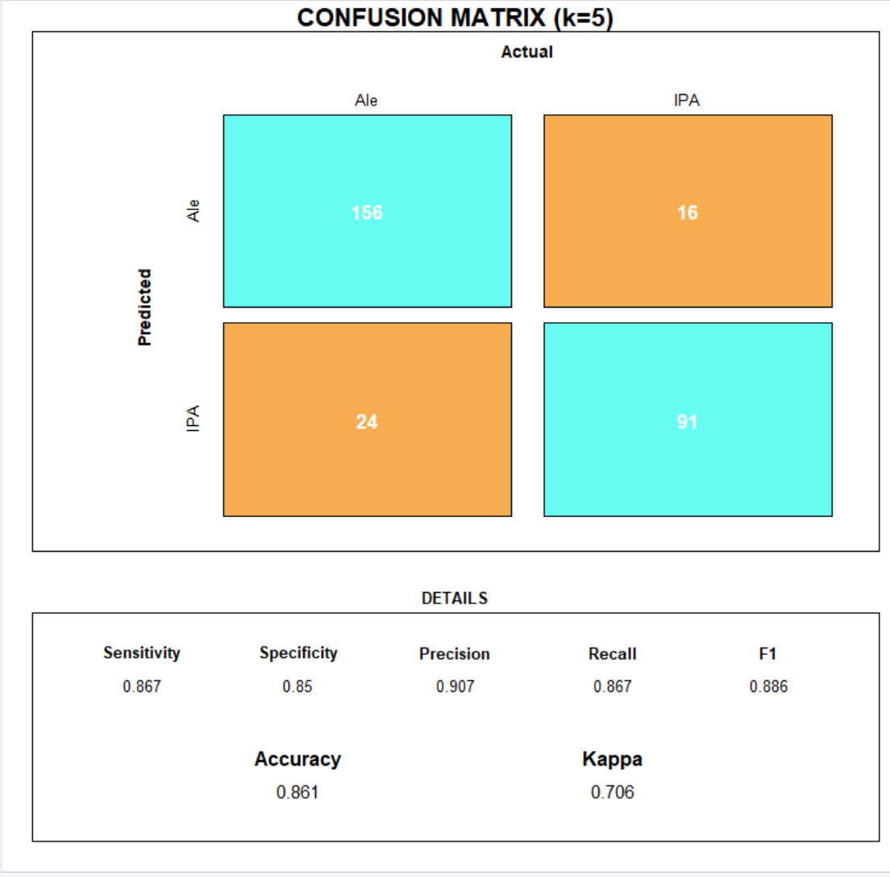
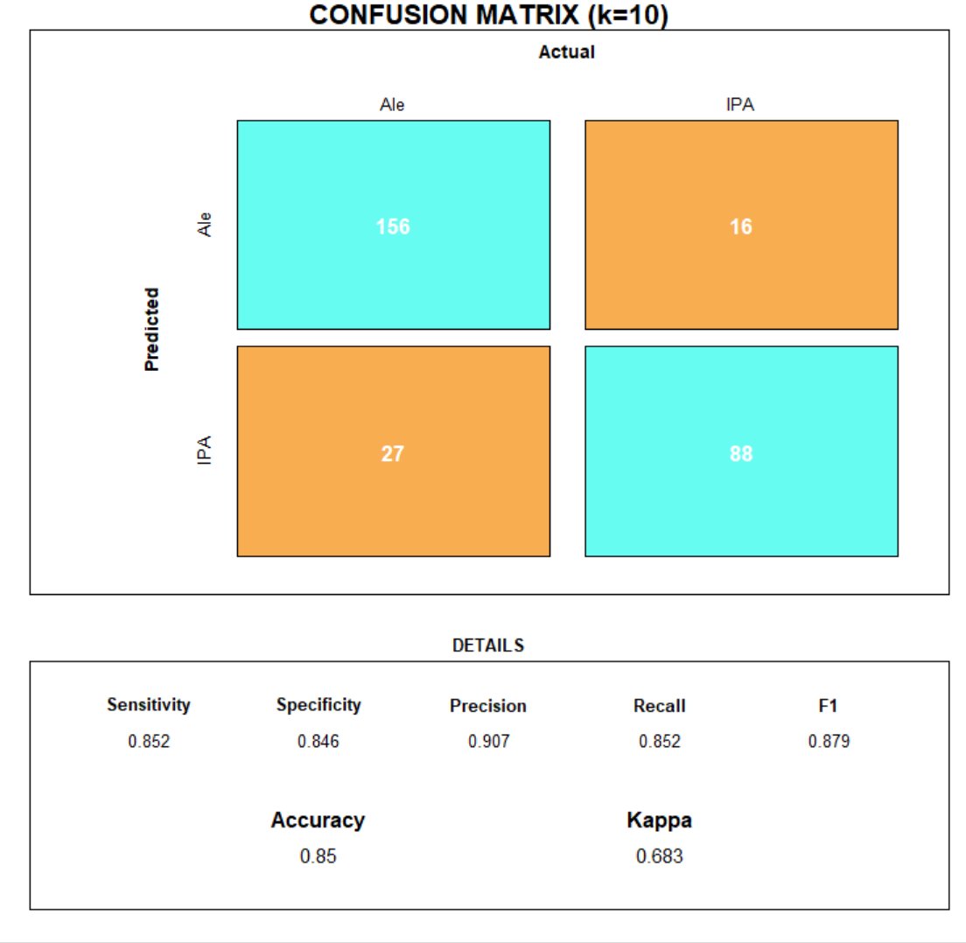
ABV vs. IBU relationship Investigation on Two Beer Styles KNN Clustering Confusion Matrix
We conduct KNN with different selection of k on the dataset and evaluate the results with confusion matrix.
Accuracy(k=5) is 0.861, Accuracy(k=10) is 0.85
Both have gain good results regarding accuracy, sensitivity and specificity. The selection of k=5 slightly better.

Slide 14
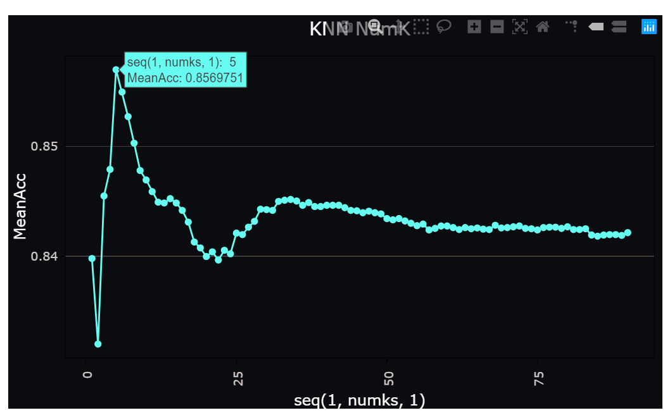
ABV vs. IBU relationship Investigation on Two Beer Styles KNN Clustering optimal K
The plot is generated from the different k-values based on the 100 different random samples.
The optimal k with this sampling group is 5.

Slide 15
ABV vs. IBU relationship Investigation on Two Beer Styles Performance Comparisons of other Methods
Method | Accuracy | Sensitivity | Specificity
KNN | 0.861 | 0.867 | 0.85
naiveBayes | 0.871 | 0.907 | 0.817
svm | 0.882 | 0.884 | 0.878
Random forest | 0.875 | 0.907 | 0.826
xgboost | 0.861 | 0.855 | 0.87
Kmeans Cluster | 0.841
The classification with different methods does not show significant differences due to high accuracy levels.
Above all methods conducted, svm and random forest shows the highest accuracy, random forest and naïveBayes show highest sensitivity, svm shows highest specificity.
By clustering the dataset with Kmeans we can also get a high accuracy which indicate further the two groups are easy to differentiate.

Slide 16
Which state to launch our next Budweiser IPA? Count % IPA per total craft beers in each state
10 States with High %IPA
State | % | Count
DE | 50 | 1
NJ | 50 | 4
VT | 44.44 | 12
CT | 33.33 | 9
ND | 33.33 | 1
TN | 33.33 | 2
FL | 32.76 | 19
WA | 32.35 | 22
CA | 31.69 | 58
UT | 30.77 | 8
These are the states with the highest IPA market share in state breweries.
Something interesting, is that we notice less populated states top the list.
That could mean less marketed consumers if we abide purely by the “market share” idea.
How can we “normalize” our data for state population?

Slide 17
Which state to launch our next Budweiser IPA? Normalized IPA by population
By using 2019 consensus data, we divide the total IPA per state by the total multiple of 100,000 residents in each state.
This approach is commonly used in government studies and proves to be effective against high and low populous states.
After our adjustment, we find the following top markets: Vermont, Colorado, Alaska, Montana and Oregon.
State | Population (in million) | IPA_per_100k
Vermont | 0.6 | 1.91
Colorado | 5.8 | 0.99
Alaska | 0.7 | 0.95
Montana | 1.1 | 0.74
Oregon | 4.2 | 0.73

Slide 18
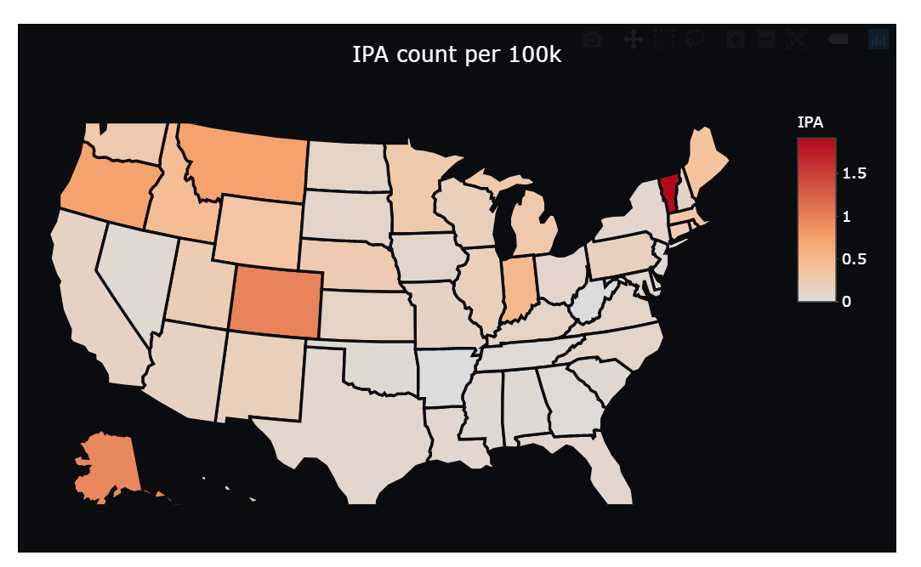
Which region to launch our next Budweiser IPA? What’s our best trial market?
The map shows a heatmap of the IPA per 100k individuals that we calculated.
By focusing on region instead of individual states, we can lower logistic costs and distribute to a wider audience.
The best region to enter is the Pacific Northwest.
The worst region to enter is the Southeast.

Slide 19
Final Recommendations
By investing in the IPA craze across the nation, we recognize that the potential top 5 markets: Vermont, Colorado, Alaska, Montana and Oregon, could be great test subjects for a Budweiser IPA.
If we would prefer to target specific regions, we recommend the Pacific Northwest as the best market to enter, and wouldn’t recommend the Southeast Region until we are more confident in mass production of the new product.

